Slide 1
CCNA 200-301, Volume I
Chapter 18
Configuring IPv4 Addresses and Static Routes

Slide 2
Objectives
IP Routing
Configuring Connected Routes
Configuring Static Routes
IP Forwarding with the Longest Prefix Match

Slide 3
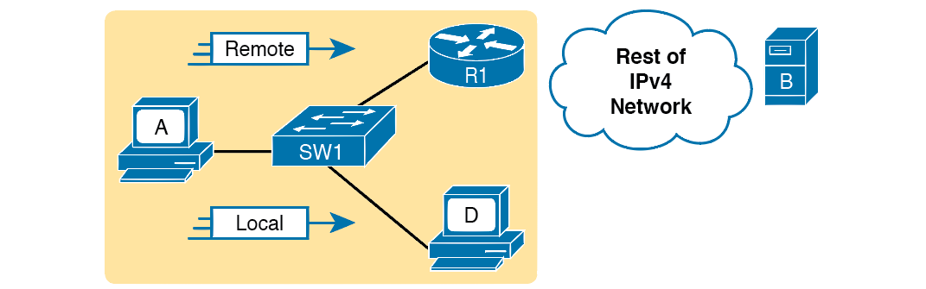
Host Routing Logic Summary

Slide 4
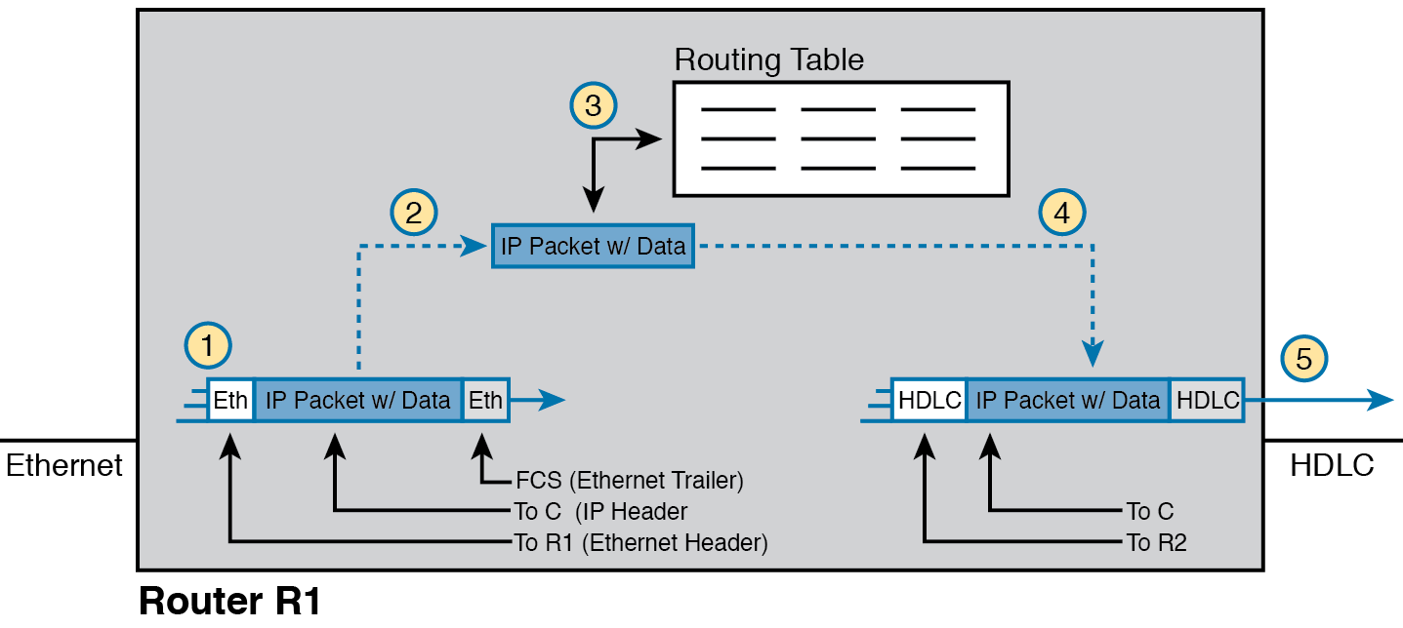
Router Routing Logic Summary

Slide 5
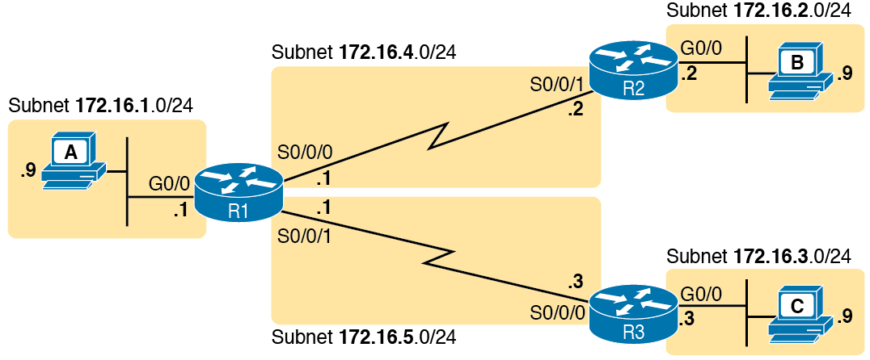
IPv4 Network Used to Show Five-Step Routing Example

Slide 6
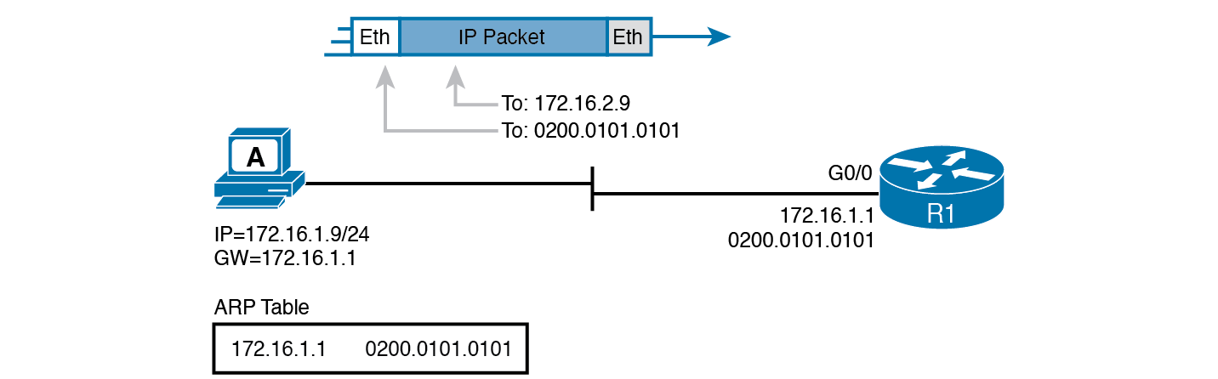
Host A Sends Packet to Host B

Slide 7
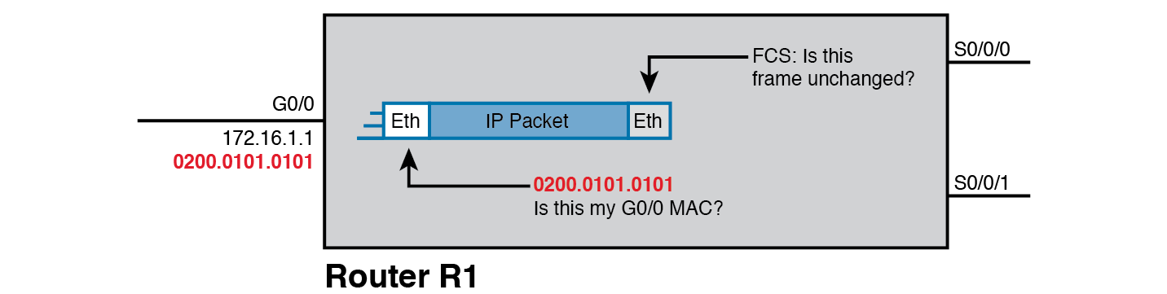
Routing Step 1, on Router R1: Checking FCS and Destination MAC

Slide 8
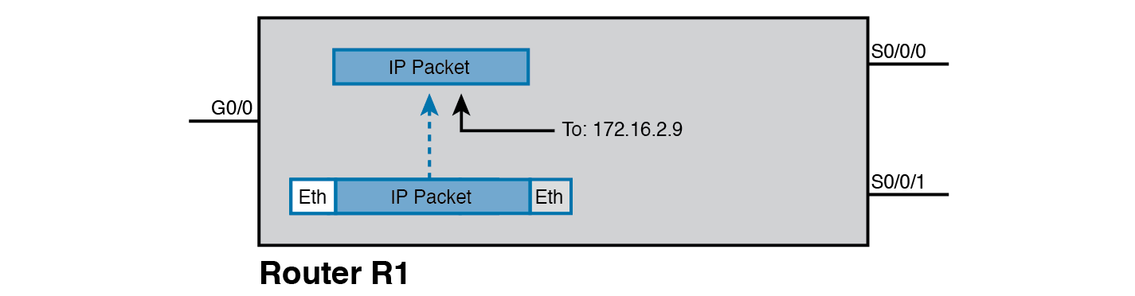
Routing Step 2 on Router R1: De-encapsulating the Packet

Slide 9
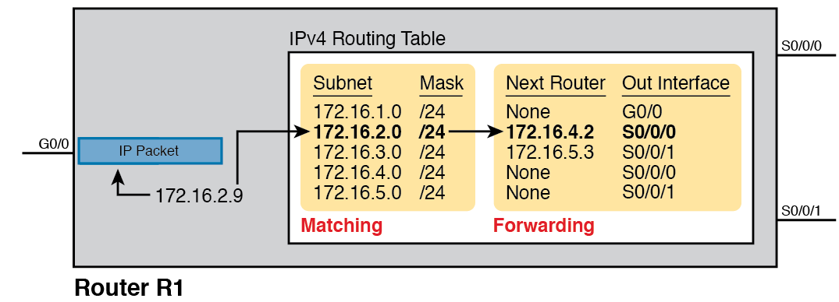
Routing Step 3 on Router R1: Matching the Routing Table

Slide 10
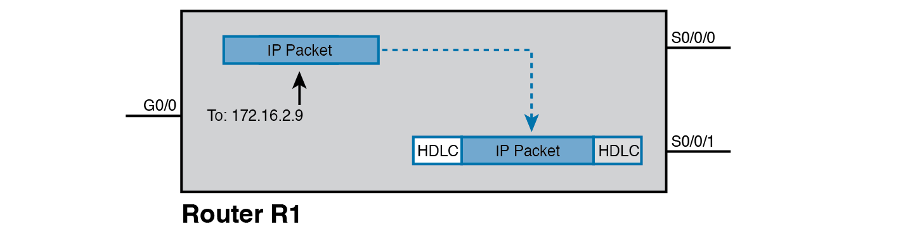
Routing Step 4 on Router R1: Encapsulating the Packet

Slide 11
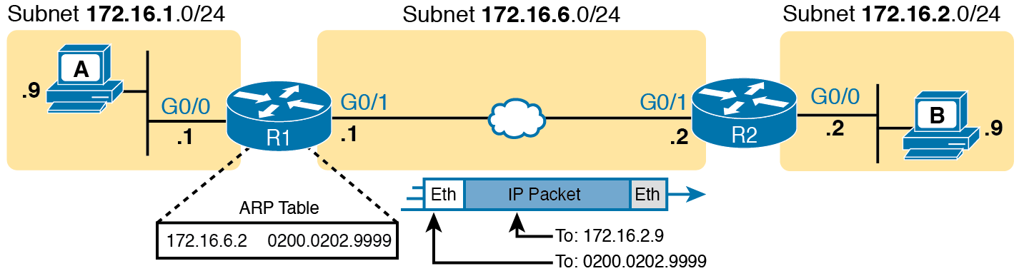
Routing Step 4 on Router R1 with a LAN Outgoing Interface

Slide 12
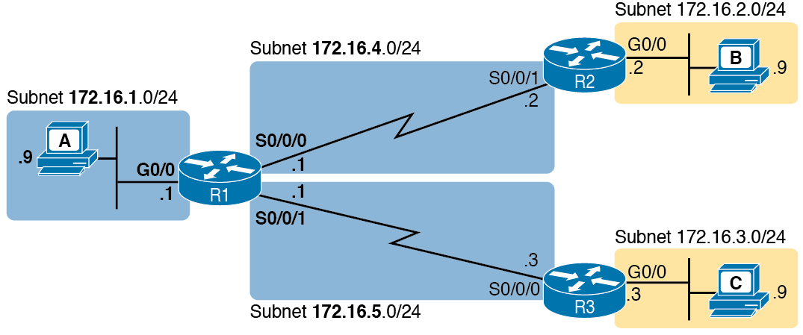
Sample Network to Show Connected Routes

Slide 13
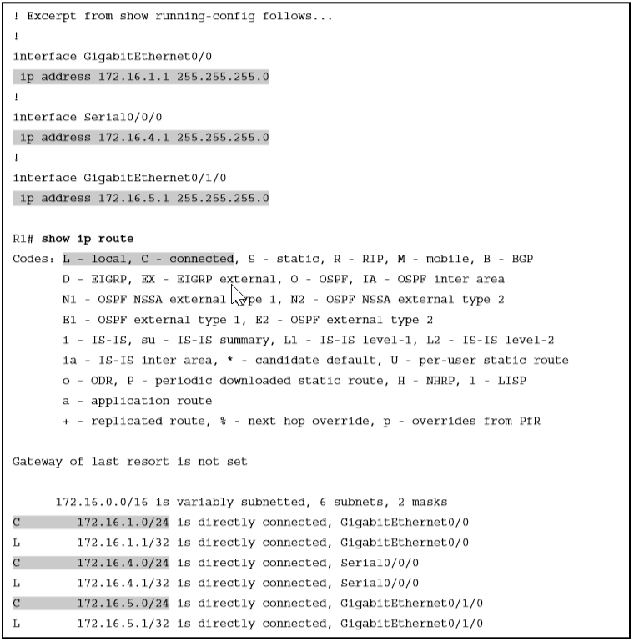
Connected and Local Routes on Router R1

Slide 14
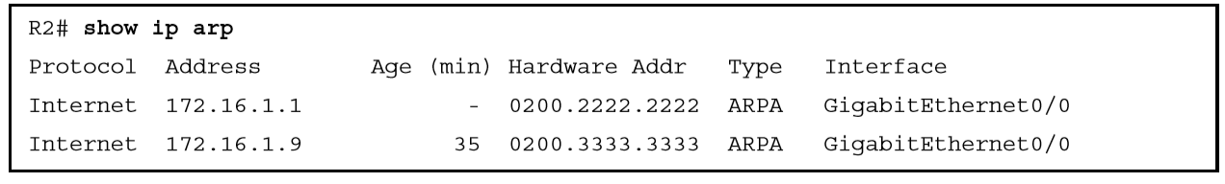
Displaying a Router’s IP ARP Table

Slide 15
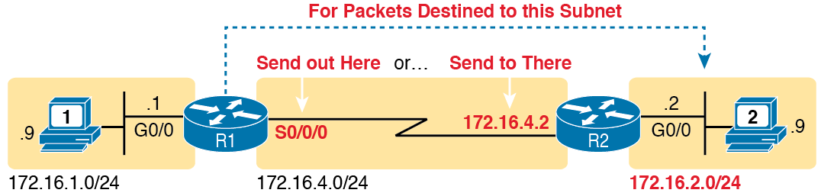
Static Route Configuration Concept

Slide 16
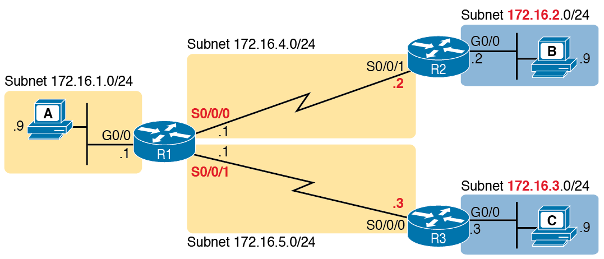
Sample Network Used in Static Route Configuration Examples

Slide 17
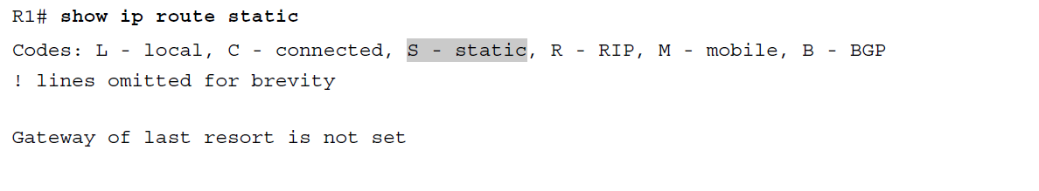
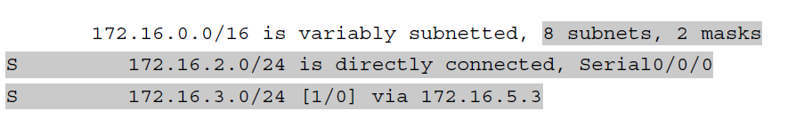
Static Routes Added to R1

Slide 18
Static Host Routes
ip route 10.1.1.0 255.255.255.0 10.2.2.2
ip route 10.1.1.9 255.255.255.255 10.9.9.9

Slide 19
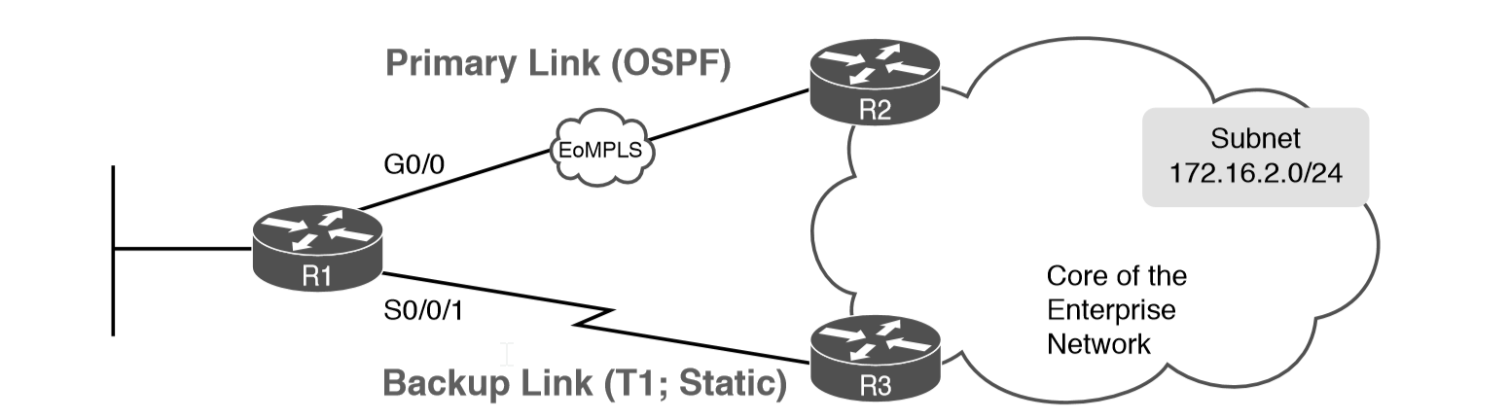
Using a Floating Static Route to Key Subnet 172.16.2.0/24

Slide 20
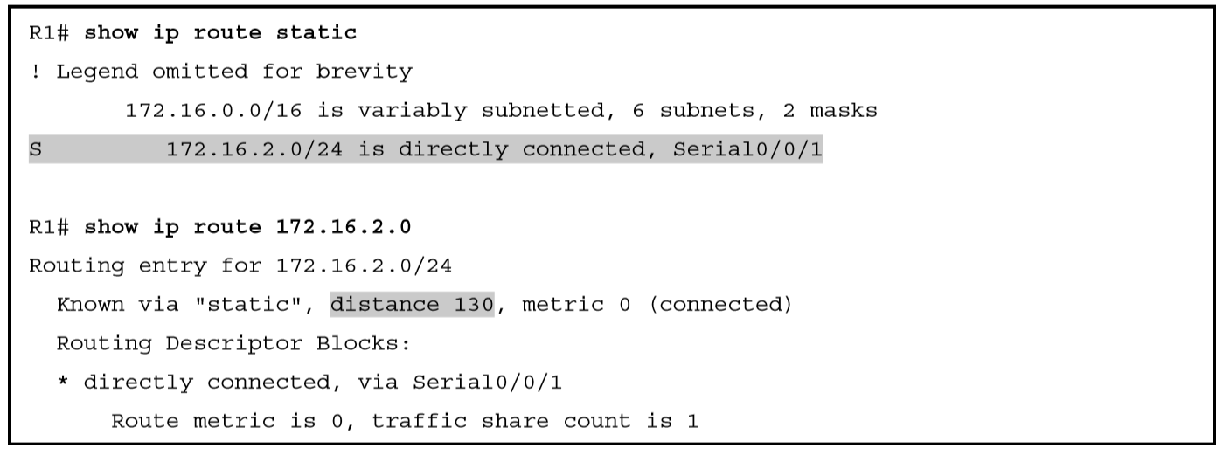
Displaying the Administrative Distance of the Static Route

Slide 21
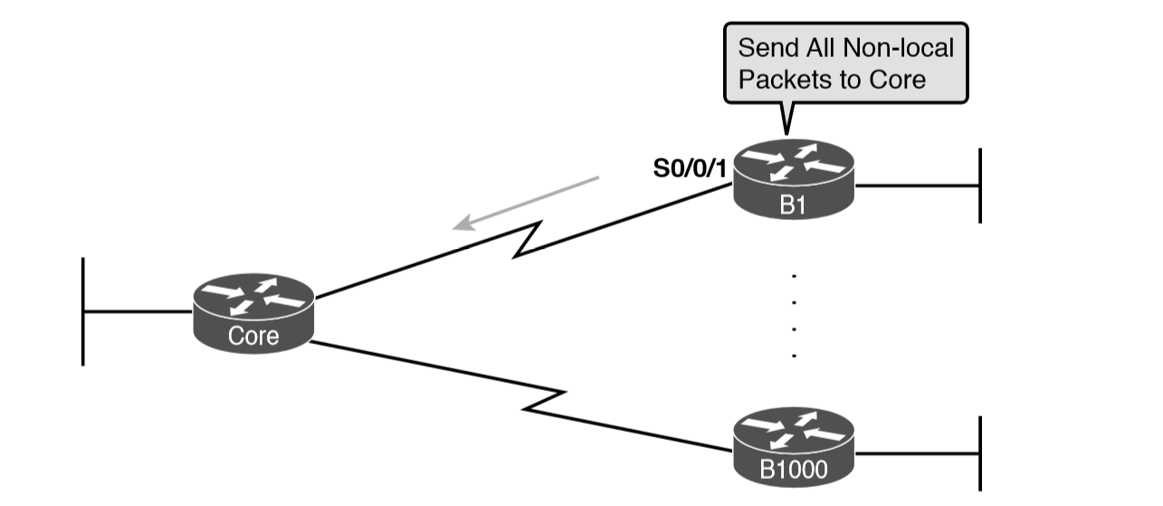
Example Use of Static Default Routes at 1000 Low-Speed Remote Sites

Slide 22
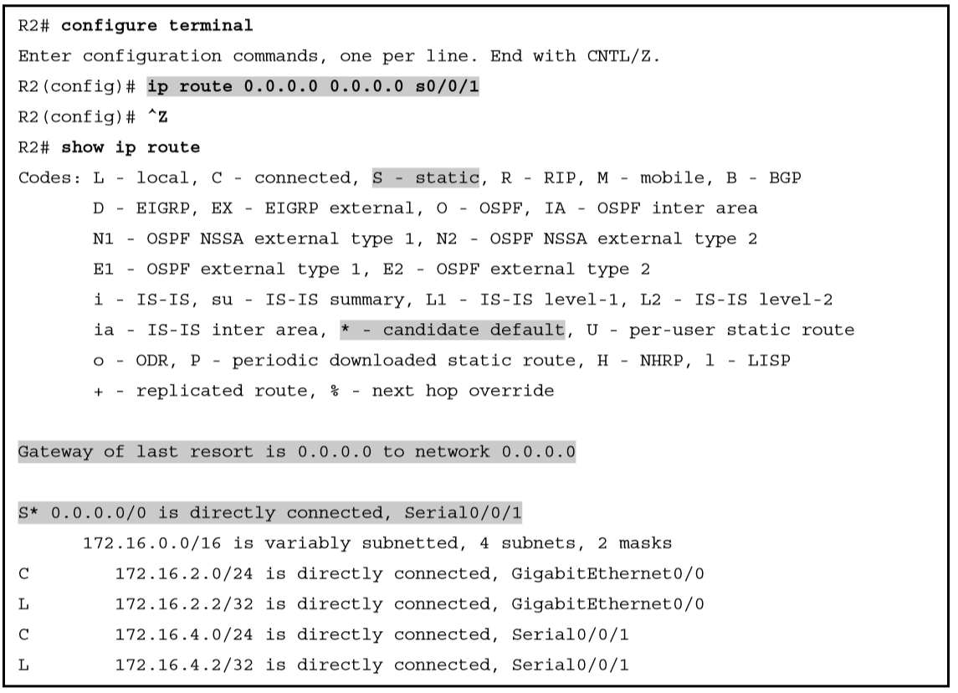
Adding a Static Default Route on R2

Slide 23
Permanently Adding Static Routes to the IP Routing Table

Slide 24
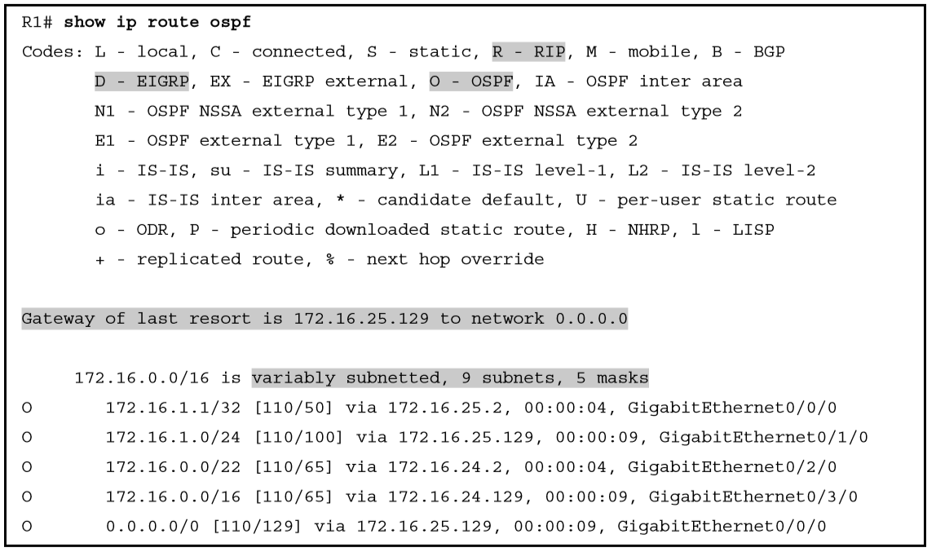
show ip route Command with Overlapping Routes

Slide 25
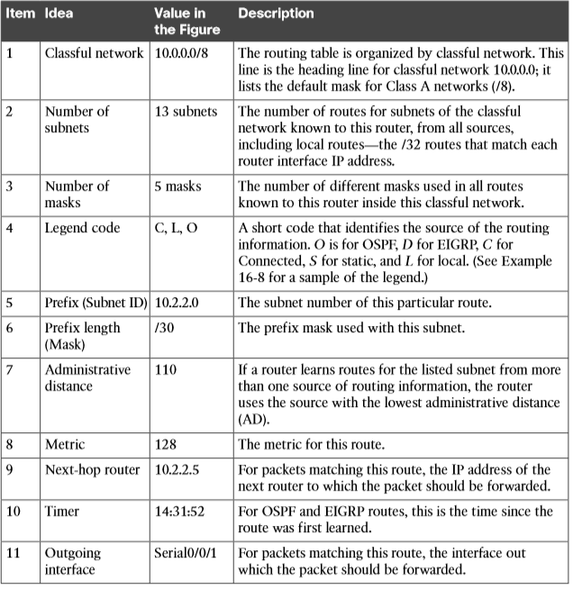
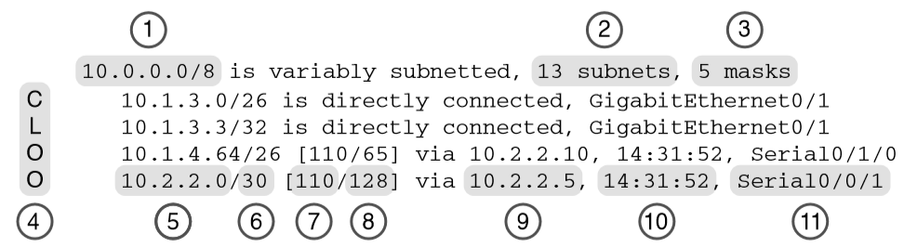
show ip route Command Output

